Slide 1
Linear Regression Maths

Slide 2
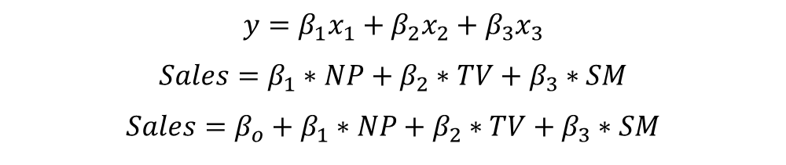
$$y=β_{1}x_{1}+β_{2}x_{2}+β_{3}x_{3}$$
$$Sales=β_{1}∗NP+β_{2}∗TV+β_{3}∗SM$$
$$Sales=β_{o}+β_{1}∗NP+β_{2}∗TV+β_{3}∗SM$$

Slide 3
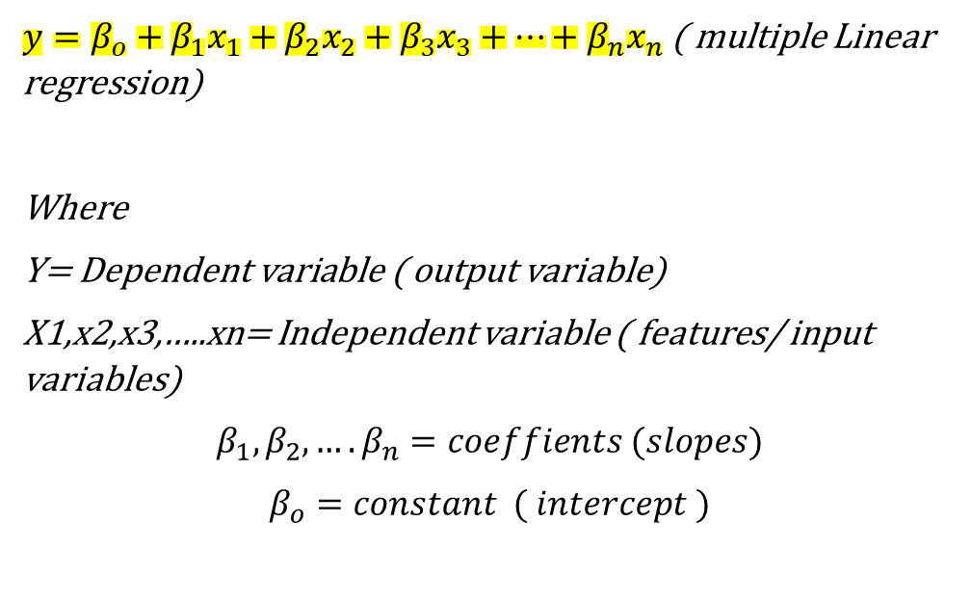
$y={β_{o}+β}_{1}x_{1}+β_{2}x_{2}+β_{3}x_{3}+…+β_{n}x_{n}$ ( multiple Linear regression)
Where
Y= Dependent variable ( output variable)
X1,x2,x3,…..xn= Independent variable ( features/ input variables)
$$β_{1},β_{2},….β_{n}=coeffients (slopes)$$
$$β_{o}=constant ( intercept )$$

Slide 4
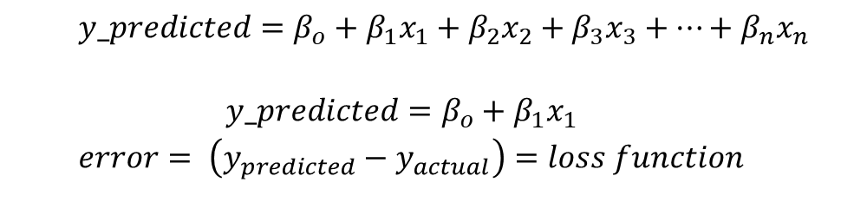
$$y_predicted={β_{o}+β}_{1}x_{1}+β_{2}x_{2}+β_{3}x_{3}+…+β_{n}x_{n}$$
$$y_predicted={β_{o}+β}_{1}x_{1}$$
$$error= \left(y_{predicted}−y_{actual}\right)=loss function$$

Slide 5
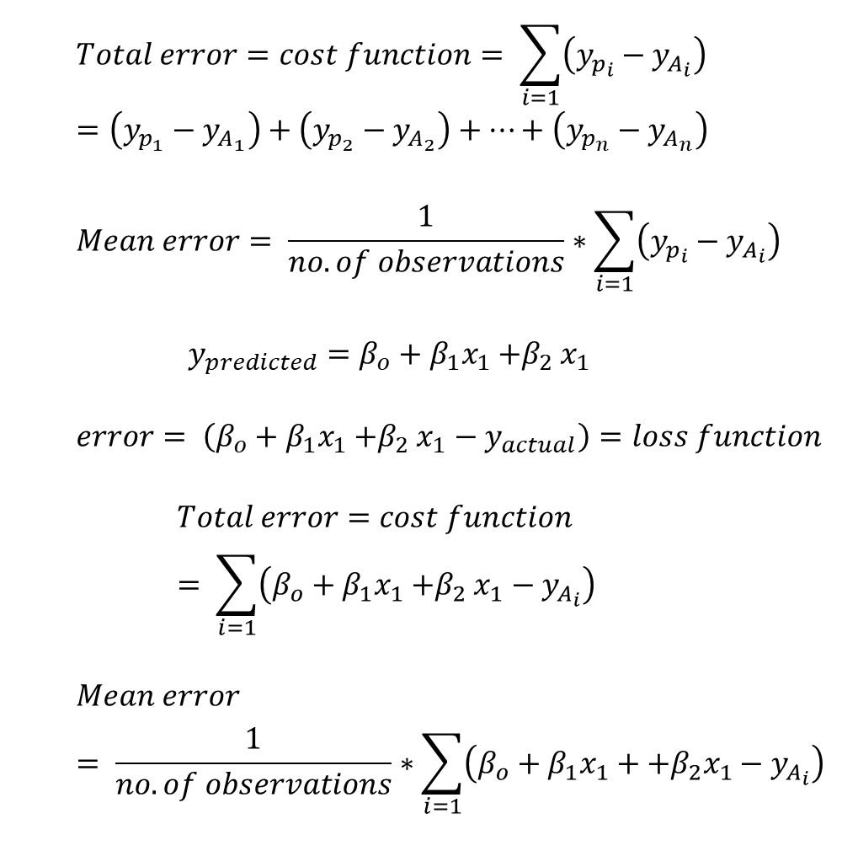
$$Total error=cost function= \sum_{i=1}{\left(y_{p_{i}}−y_{A_{i}}\right)}=\left(y_{p_{1}}−y_{A_{1}}\right)+\left(y_{p_{2}}−y_{A_{2}}\right)+…+\left(y_{p_{n}}−y_{A_{n}}\right)$$
$$Mean error= \frac{1}{no.of observations}∗\sum_{i=1}{\left(y_{p_{i}}−y_{A_{i}}\right)}$$
$$y_{predicted}={β_{o}+β}_{1}x_{1}{+β}_{2}x_{1}$$
$$error= \left({β_{o}+β}_{1}x_{1}{+β}_{2}x_{1}−y_{actual}\right)=loss function$$
$$Total error=cost function= \sum_{i=1}{\left({β_{o}+β}_{1}x_{1}{+β}_{2}x_{1}−y_{A_{i}}\right)}$$
$$Mean error= \frac{1}{no.of observations}∗\sum_{i=1}{\left({β_{o}+β}_{1}x_{1}+{+β}_{2}x_{1}−y_{A_{i}}\right)}$$

Slide 6
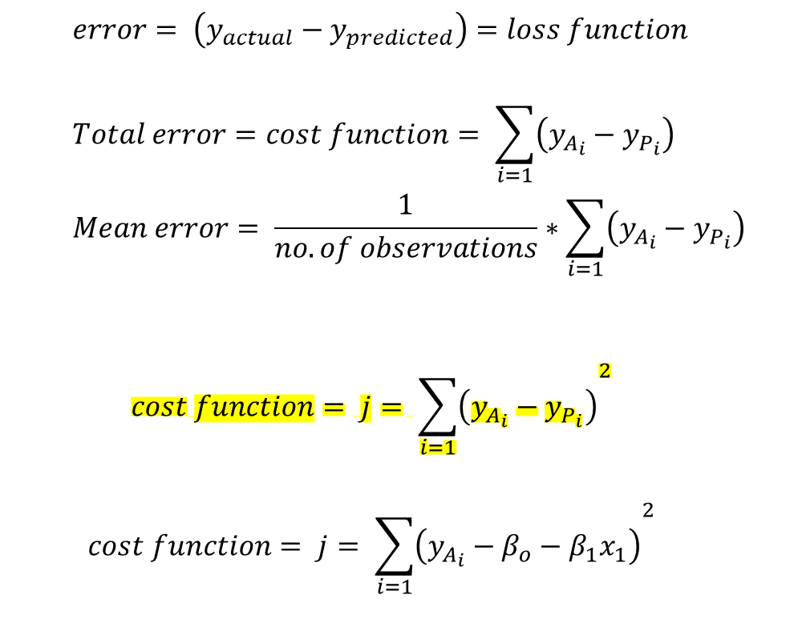
$$error= \left(y_{actual}−y_{predicted}\right)=loss function$$
$$Total error=cost function= \sum_{i=1}{\left(y_{A_{i}}−y_{P_{i}}\right)}$$
$$Mean error= \frac{1}{no.of observations}∗\sum_{i=1}{\left(y_{A_{i}}−y_{P_{i}}\right)}$$
$$cost function= j= {\sum_{i=1}{\left(y_{A_{i}}−y_{P_{i}}\right)}}^{2}$$
$$cost function= j= {\sum_{i=1}{\left(y_{A_{i}}−{β_{o}−β}_{1}x_{1}\right)}}^{2}$$

Slide 7
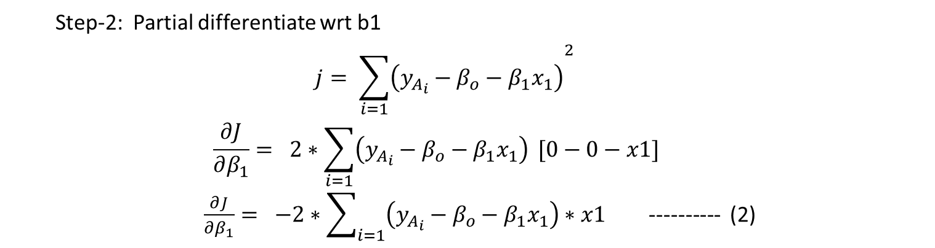
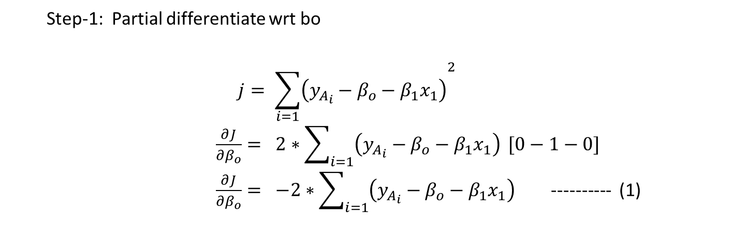
Step-1: Partial differentiate wrt bo
$$j= {\sum_{i=1}{\left(y_{A_{i}}−{β_{o}−β}_{1}x_{1}\right)}}^{2}$$
$\frac{∂J}{∂β_{o}}= {2∗\sum_{i=1}{\left(y_{A_{i}}−{β_{o}−β}_{1}x_{1}\right)} [0−1−0]}^{}$
$\frac{∂J}{∂β_{o}}= {−2∗\sum_{i=1}{\left(y_{A_{i}}−{β_{o}−β}_{1}x_{1}\right)} }^{}$ ---------- (1)
Step-2: Partial differentiate wrt b1
$$j= {\sum_{i=1}{\left(y_{A_{i}}−{β_{o}−β}_{1}x_{1}\right)}}^{2}$$
$$\frac{∂J}{∂β_{1}}= {2∗\sum_{i=1}{\left(y_{A_{i}}−{β_{o}−β}_{1}x_{1}\right)} [0−0−x1]}^{}$$
$\frac{∂J}{∂β_{1}}= {−2∗\sum_{i=1}{\left(y_{A_{i}}−{β_{o}−β}_{1}x_{1}\right)}∗x1 }^{}$ ---------- (2)

Slide 8
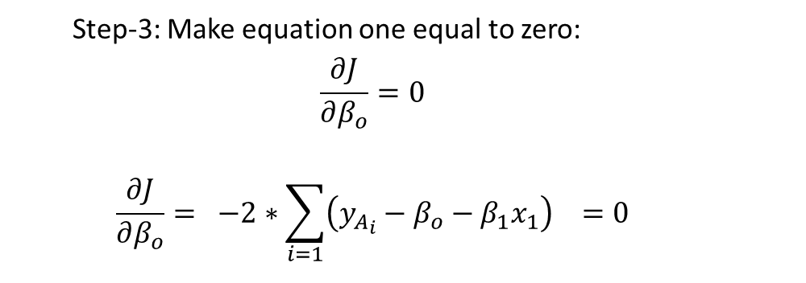
Step-3: Make equation one equal to zero:
$$\frac{∂J}{∂β_{o}}=0$$
$$\frac{∂J}{∂β_{o}}= {−2∗\sum_{i=1}{\left(y_{A_{i}}−{β_{o}−β}_{1}x_{1}\right)} }^{}=0$$

Slide 9

$−2∗\sum_{i=1}{\left(y_{A_{i}}−{β_{o}−β}_{1}x_{1}\right)}=0$
$\sum_{i=1}{\left(y_{A_{i}}−{β_{o}−β}_{1}x_{1}\right)}=0$
$\sum_{i=1}^{n}{y_{A_{i}}−}\sum_{i=1}^{n}{β_{o}− \sum_{i=1}^{n}{β_{1}x_{1}=0 }}$
$\sum_{i=1}^{n}{y_{A_{i}}=\sum_{i=1}^{n}{β_{o}+\sum_{i=1}^{n}{β_{1}x_{1} }}}$
$\sum_{i=1}^{n}{y_{A_{i}}=\sum_{i=1}^{n}{β_{o}+β_{1}∗\sum_{i=1}^{n}{x_{1} }}}$
$\sum_{i=1}^{n}{β_{o}=}n∗β_{o}$
$\sum_{i=1}^{n}{y_{A_{i}}−β_{1}∗\sum_{i=1}^{n}{x_{1} }=n∗β_{o}}$
$β_{o}=\frac{1}{n}∗\sum_{i=1}^{n}{y_{A_{i}}−{ β}_{1}∗\frac{1}{n}∗ \sum_{i=1}^{n}{x_{1} }}$
$β_{o}=\overline{y_{A}}−β_{1}∗\overline{x1}$

